Slide 1
Object Detection in Medical Images
IN4307- Medical Visuallization Final Project
Maria Silos Viu - 4501888
Meghna Hukeri - 4477871

Slide 2
Problem to be solved
Identification of objects in medical images needs to be automated
Reduces the possiblity of human errors like incorrect diagnosis
Overall process speed increased significantly
Our work- Detecting femoral head in 2D X Ray Image.

Slide 3
Histogram of Oriented Gradients
Object shape/appearance in image can be described as a distribution of intensity gradients or edge directions.
Image divided into small regions(cells); histograms of gradient direction for each pixel in a particular ’cell’ computed.
HOG descriptor made by concatenating all histograms from each cell.
Histograms contrast normalized across ’block’ (larger spatial region); eventually over all cells in block for better accuracy.

Slide 4
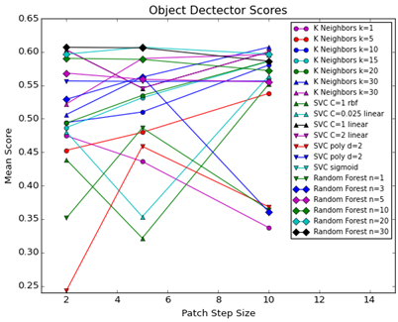
Varying Step Size

Slide 5
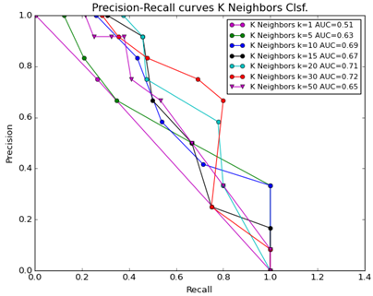
Precision Recall Curves – evaluating Classifier Performance
For kNN

Slide 6
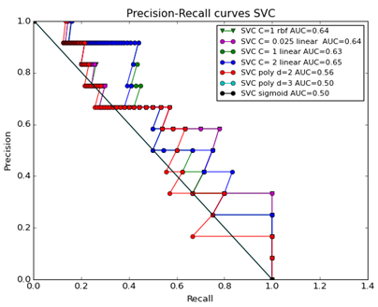
Precision Recall Curves – evaluating Classifier Performance
For SVC

Slide 7
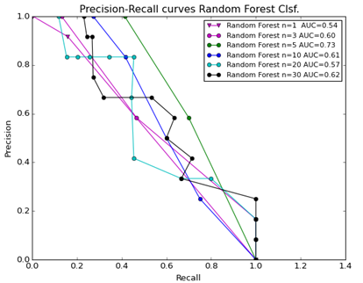
Precision Recall Curves – evaluating Classifier Performance
For RF

Slide 8
Varying Step Size : kNN
STEP SIZE | APPROACH | K = 1 | K = 5 | K = 10 | K = 15 | K = 20 | K = 30 | K = 50
2 | NMS | 0.47453661 | 0.45291091 | 0.4943792 | 0.4868804 | 0.49361804 | 0.50637757 | 0.5222742
2 | PROB | 0.58592557 | 0.58971792 | 0.56406242 | 0.55095455 | 0.57022926 | 0.57245187 | 0.60009086
5 | NMS | 0.43622989 | 0.47979826 | 0.51014308 | 0.53142769 | 0.53503827 | 0.56225822 | 0.59009646
5 | PROB | 0.54684236 | 0.5662166 | 0.5662166 | 0.56232215 | 0.57125688 | 0.59641601 | 0.59543465
10 | NMS | 0.33737008 | 0.53781582 | 0.58021164 | 0.5859107 | 0.58606455 | 0.60702625 | 0.5960793
10 | PROB | 0.43807073 | 0.60084976 | 0.60159393 | 0.60680291 | 0.59149686 | 0.60702625 | 0.5960793

Slide 9
Varying Step Size : SVC
STEP SIZE | APPROACH
2 | NMS
2 | PROB
5 | NMS
5 | PROB
10 | NMS
10 | PROB
SVC_C1_rbf | C=0.025 , linear | C = 1, linear | C = 2, linear | D = 2 , poly | D = 3 , poly
0.43873178 | 0.48027833 | 0.60282856 | 0.60282856 | 0.24333916 | 0.55651116
0.55266051 | 0.55266051 | 0.60264451 | 0.60264451 | 0.55420429 | 0.55651116
0.32161507 | 0.35357573 | 0.5457461 | 0.5457461 | 0.45874595 | 0.55576023
0.59431896 | 0.59030138 | 0.55553689 | 0.55553689 | 0.55576023 | 0.55576023
0.5515432 | 0.56369678 | 0.60004835 | 0.60004835 | 0.36838999 | 0.55629491
0.57353583 | 0.57353583 | 0.60004835 | 0.60004835 | 0.51938575 | 0.55629491

Slide 10
Varying Step Size : Random Forest
STEP SIZE | APPROACH
2 | NMS
2 | PROB
5 | NMS
5 | PROB
10 | NMS
10 | PROB
N = 1 | N = 3 | N = 5 | N = 10 | N = 20 | N = 30
0.35169036 | 0.5291138 | 0.56823524 | 0.59026443 | 0.59663315 | 0.6068805
0.45826099 | 0.59639229 | 0.59976928 | 0.60069991 | 0.6029957 | 0.60705809
0.48633287 | 0.56251499 | 0.558926 | 0.58885168 | 0.60702625 | 0.60604489
0.493759 | 0.56828395 | 0.60581999 | 0.59875148 | 0.60702625 | 0.60604489
0.36398407 | 0.36104436 | 0.55521173 | 0.57196058 | 0.59681411 | 0.5861361
0.40952757 | 0.3947076 | 0.58876555 | 0.57464964 | 0.59681411 | 0.5861361

